Slide 1
Flight Data Analysis
Course: Big Data System Engineering Using Scala
Professor: Robin Hillyard
Team-13: Vaishak, Saravan & Nandeep

Slide 2
Goals of the project
Building a reactive application using Akka (Actor Model) framework and Play framework
Analyze the flight price and popular destination trends from the available listing dataset using Spark
Provide user with cheap flights using Web APIs and Spark Streaming for the given source and destination

Slide 3
Use Case
System analyzes flight data from previous years
User inputs source and destination to get the top ten cheapest flights
User enters source city to get cheapest destinations from that source city
User inputs source and destination to get the cheapest trip
User inputs source and destination to get the cheapest one-way trip

Slide 4
Data Sources
The flight APIs return an average of 50-100 records for a date range spanning day. The number of records returned vary depending on source, destination and date range.
The spark analysis of historical data took into account approximately 60 million rows which roughly translate to 30 GB.

Slide 5
Methodology
Initially collect all the data required to perform the analysis
Design an architecture for the application, to incorporate spark and Scala's play framework
Use Akka’s Actor model to abstract multi-threading
Use Spark and Spark Streaming to do the analysis on the data
Provide a web interface using the Play framework to present a well organized and collected display of the information, analysis and inferences

Slide 6
Technical Aspects
Code Repo: https://github.com/saravanvadivel/ScalaFinalProjectIn
Scala:
Akka Actors
Monads (Futures, Options, Try etc.)
Implicits, Serialization/ Deserialization and Pattern matching
information extraction using case classes
Kafka
HBase
Spark:
Spark-SQL (DataFrames)
Spark Streaming
In Play:
A reactive web UI
Backend to support the UI

Slide 7
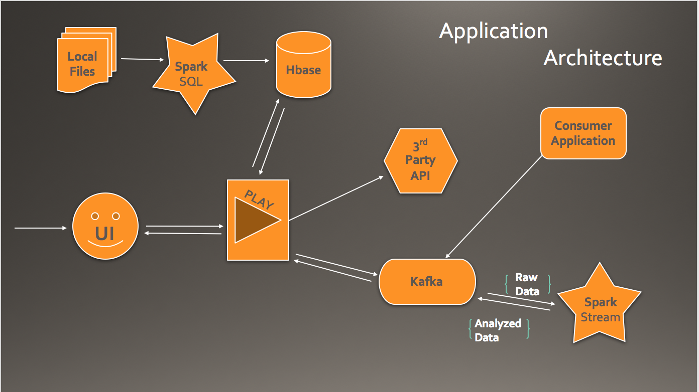
Application Architecture

Slide 8
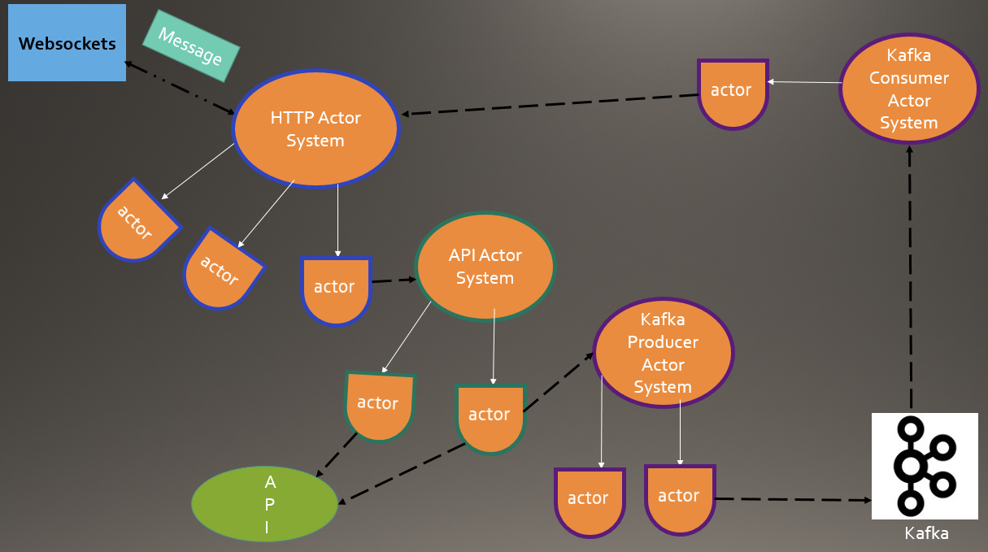
Akka Actor Model

Slide 9
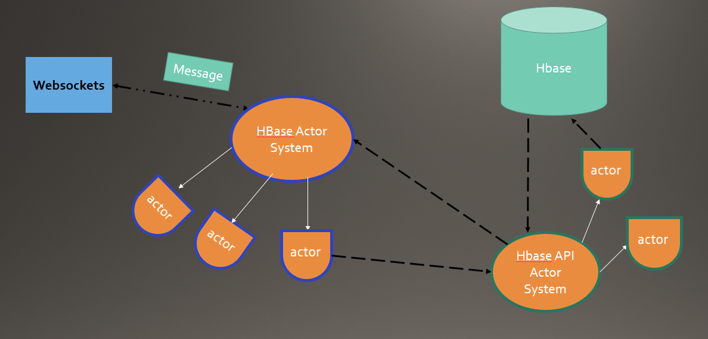
Akka Actor Model

Slide 10
Why Akka Actors
Provides a higher level of abstraction for writing concurrent and distributed system
Light weight
Easy to manage actors life cycle
Fault tolerant

Slide 11
Why Kafka
Used in real time streaming data architectures to provide real time analytics
Fast, scalable, durable, fault tolerant publish-subscribe messaging system
Reliable, high throughput and replication
Easy to integrate with Spark Streaming and HBase

Slide 12
Why Spark-SQL and Streaming
DataFrames API and Spark-SQL are much more intuitive than using RDD’s
Easier SQL Syntax and in-memory processing
Performance Optimization – Creates logical plans and translates them to multiple physical plans and chooses the most optimal plan
Some of the functions executed with Spark-SQL
Join the datasets to get the whole data
Filter the unused columns and outliers
Aggregations and Group By
Top K records
In-memory real time processing of data using Spark Streaming
Fault tolerant and batch processing

Slide 13
Milestones
Task | Time Period
Find Datasets and API | Nov 12 – Nov 17
Architecture Design | Nov 18 – Nov 20
Initial Project Skeleton and Research | Nov 21 – Nov 23
Development | Nov 27 – Dec 8
UI and Complete system Testing | Dec 9 – Dec 13

Slide 14
Acceptance Criteria
Achieved 60% accuracy of our prediction for most economical airline and destinations for a quarter when compared to actual data.
Achieved 75% accuracy for our recommendation of the cheapest flight prices based on source, destination and dates by gathering and comparing real time data from various available web APIs.

Slide 15
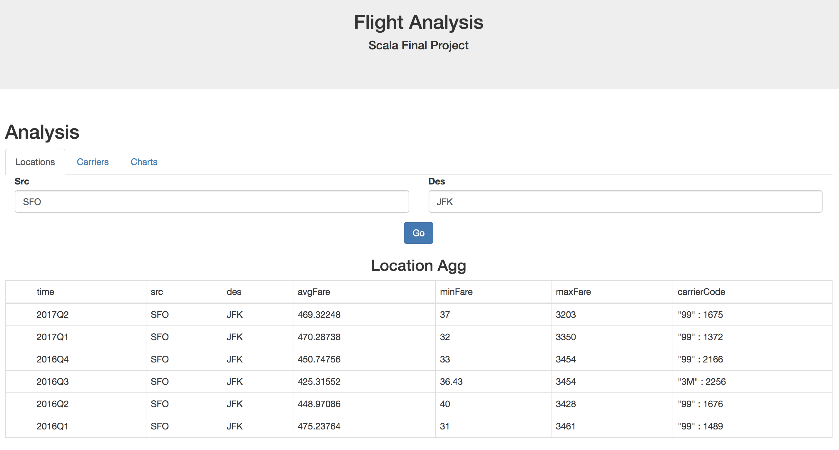
Screenshot

Slide 16
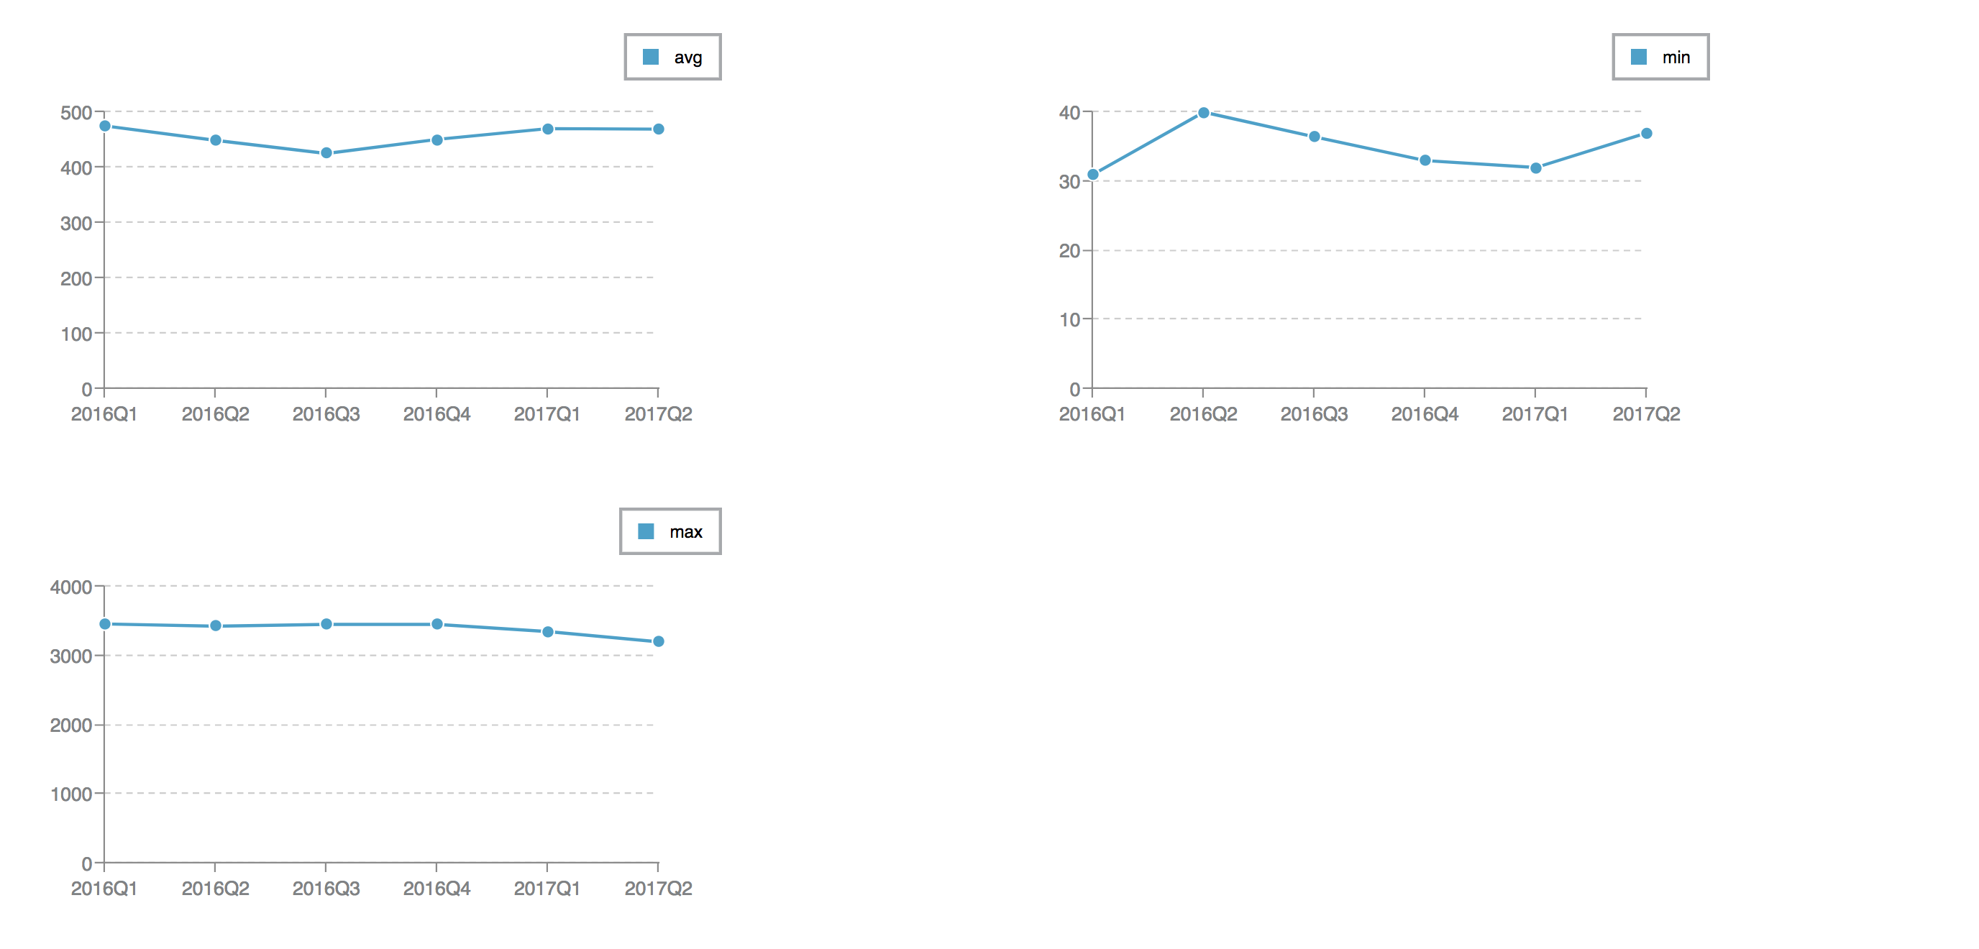
Screenshot

Slide 17
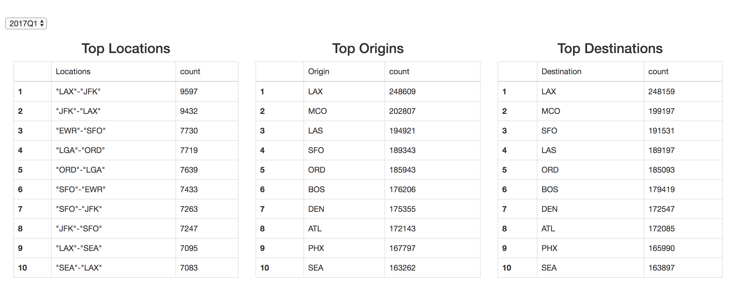
Screenshot

Slide 18
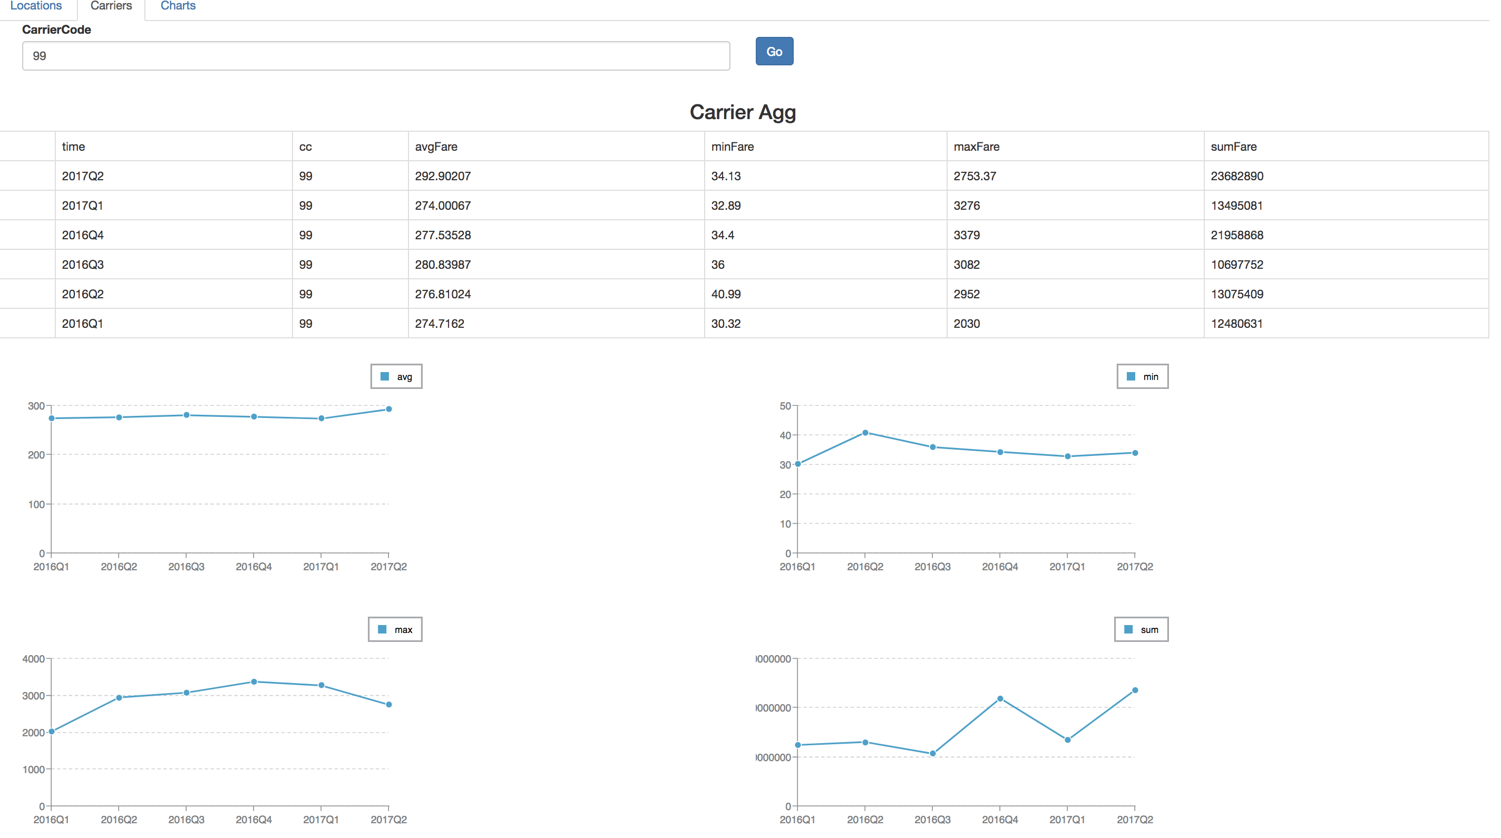
Screenshot

Slide 19
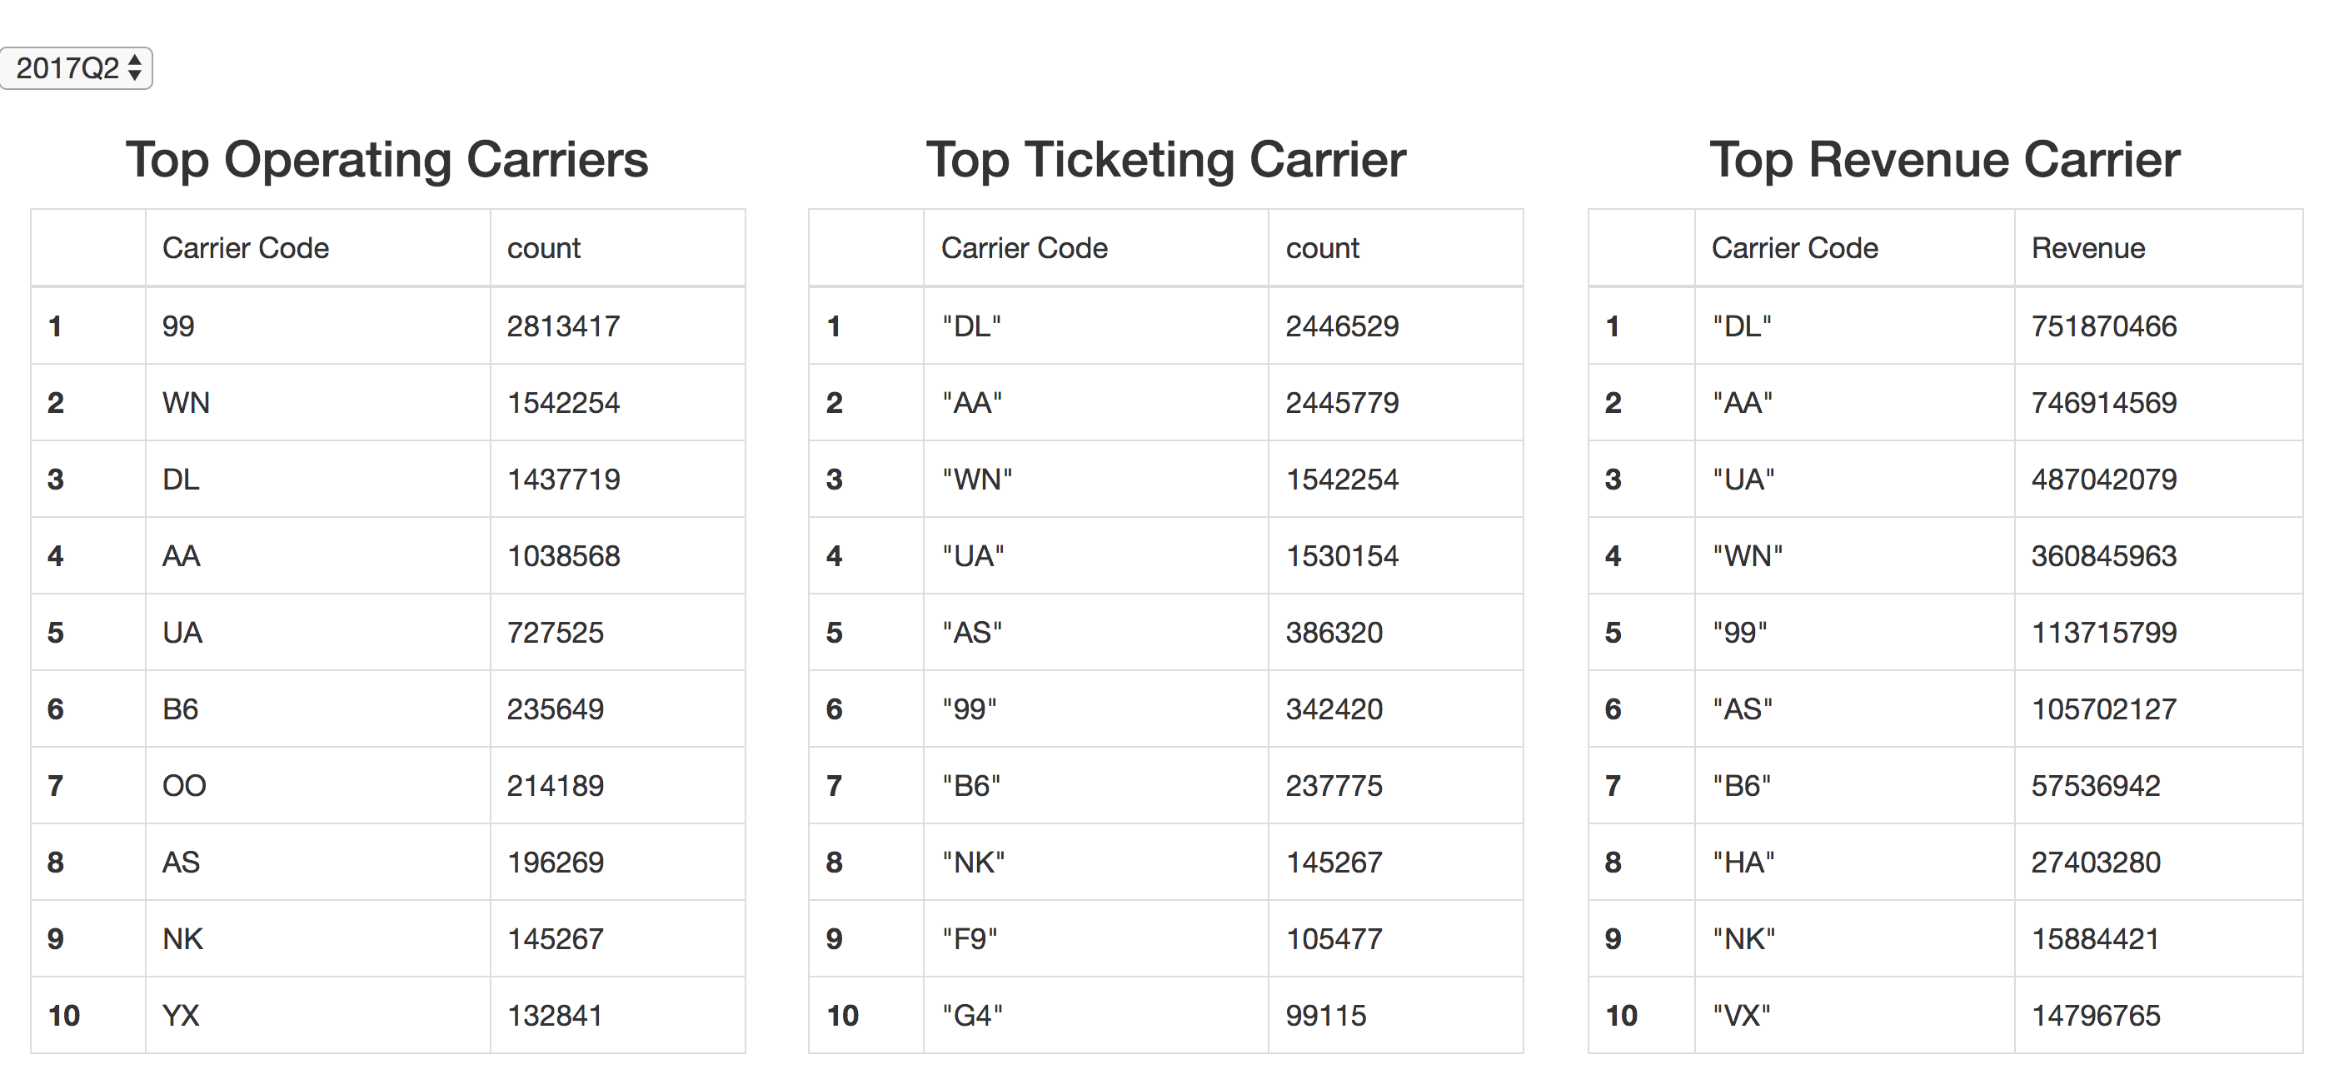
Screenshot

Slide 20
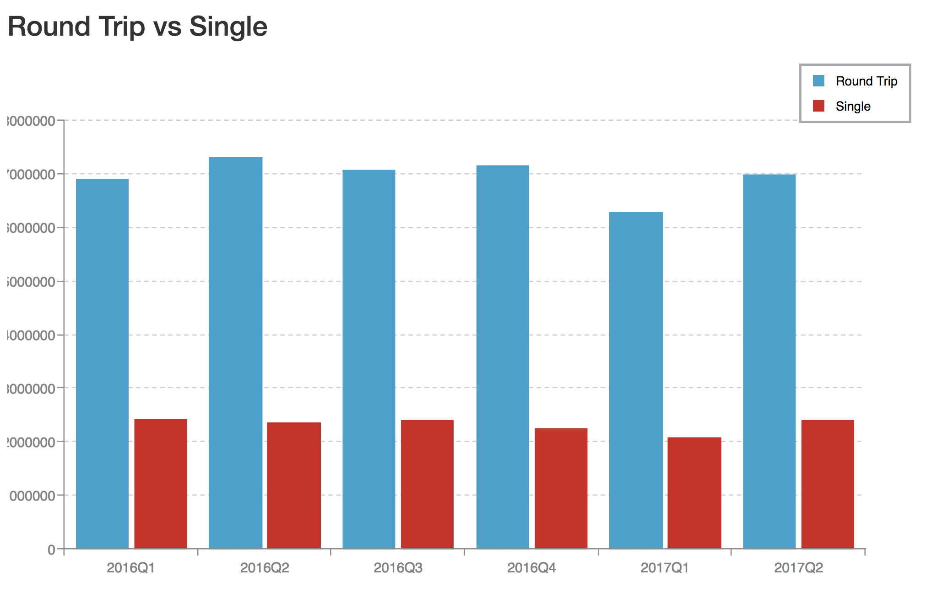
Screenshot

Slide 21
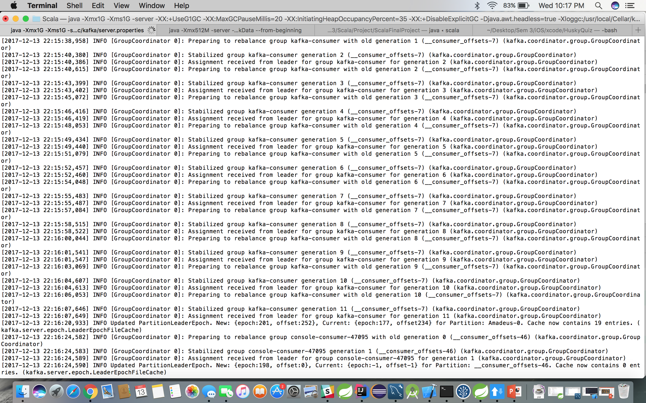
Screenshot (Kafka logs server)

Slide 22
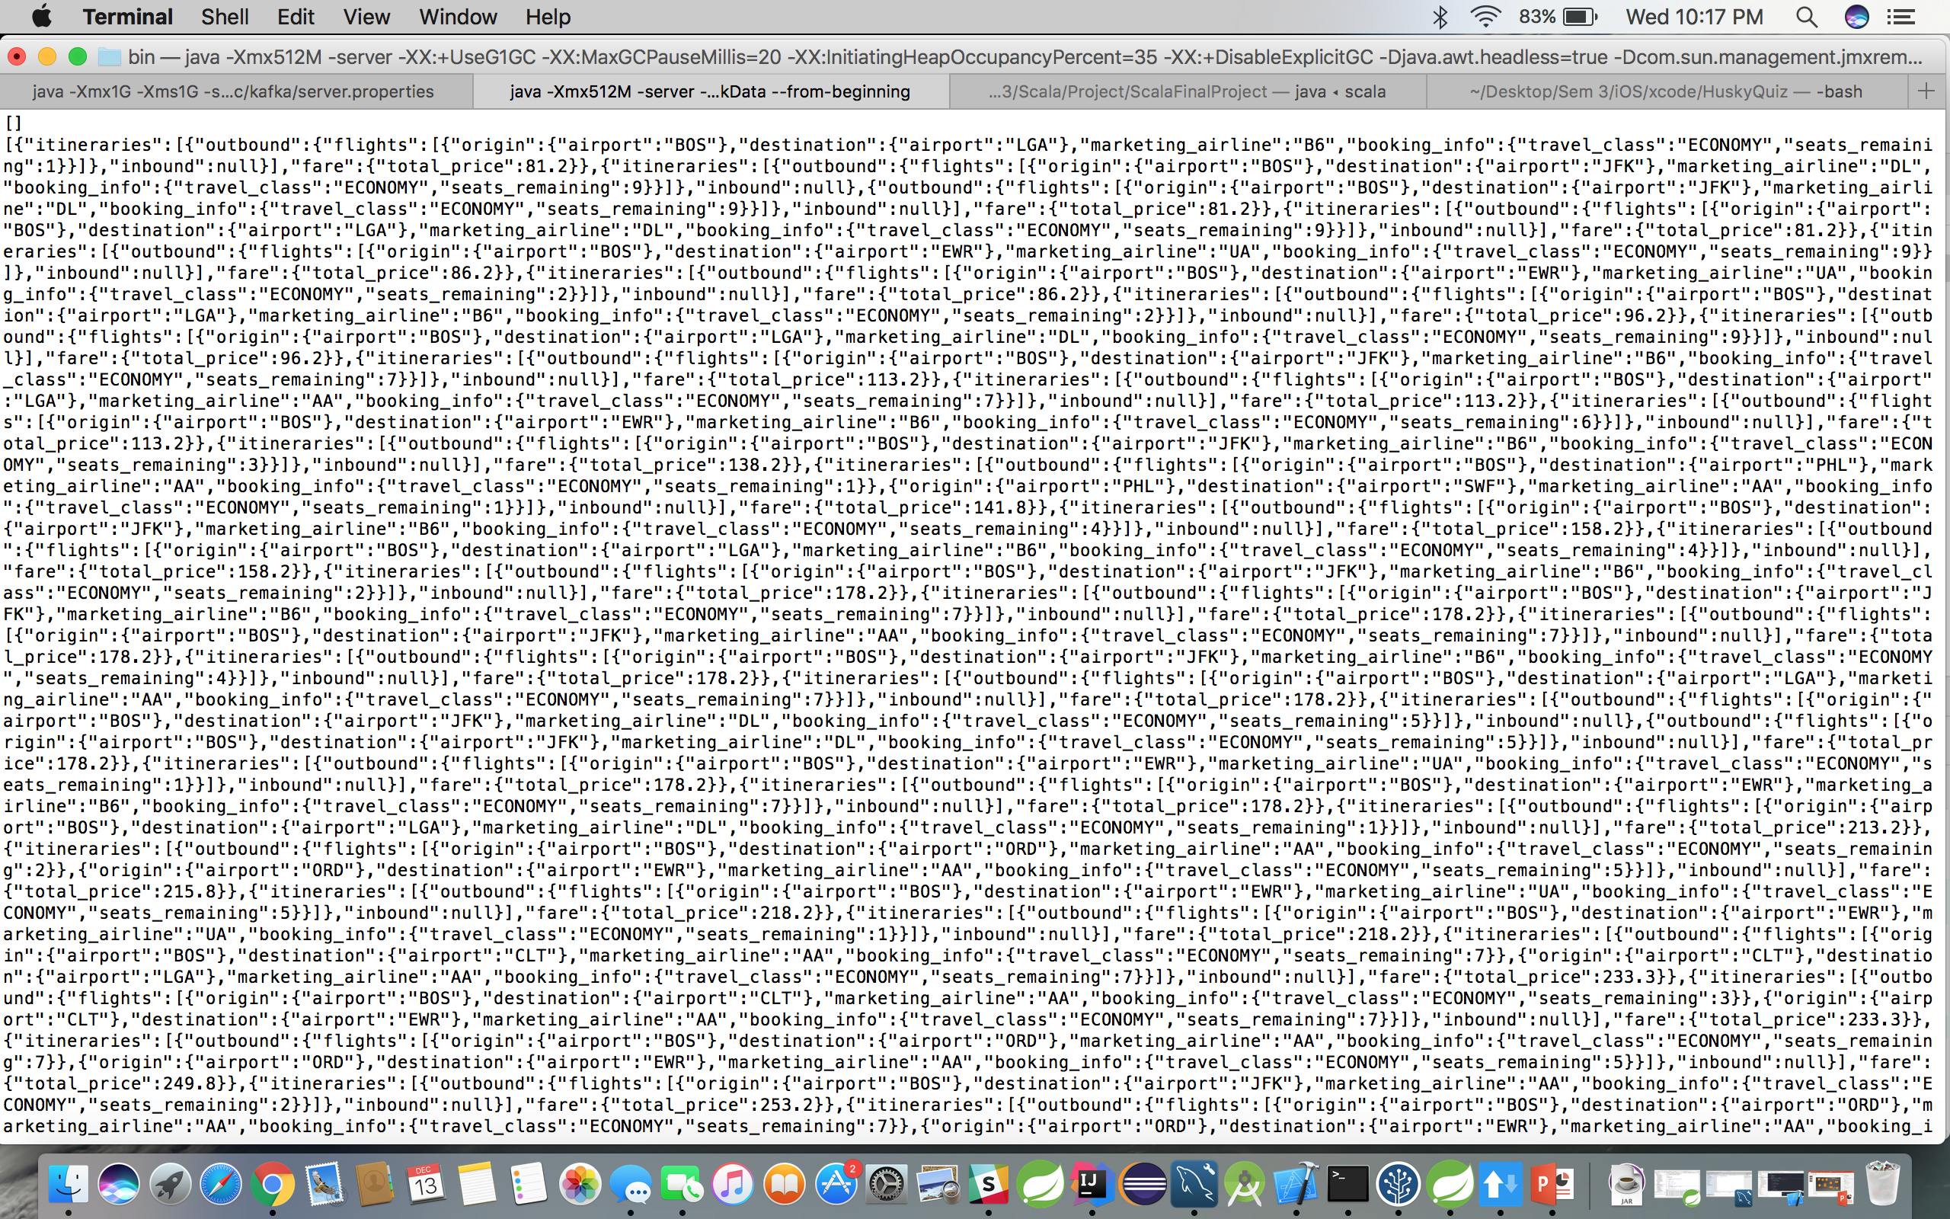
Screenshot (Kafka consumer app)

Slide 23
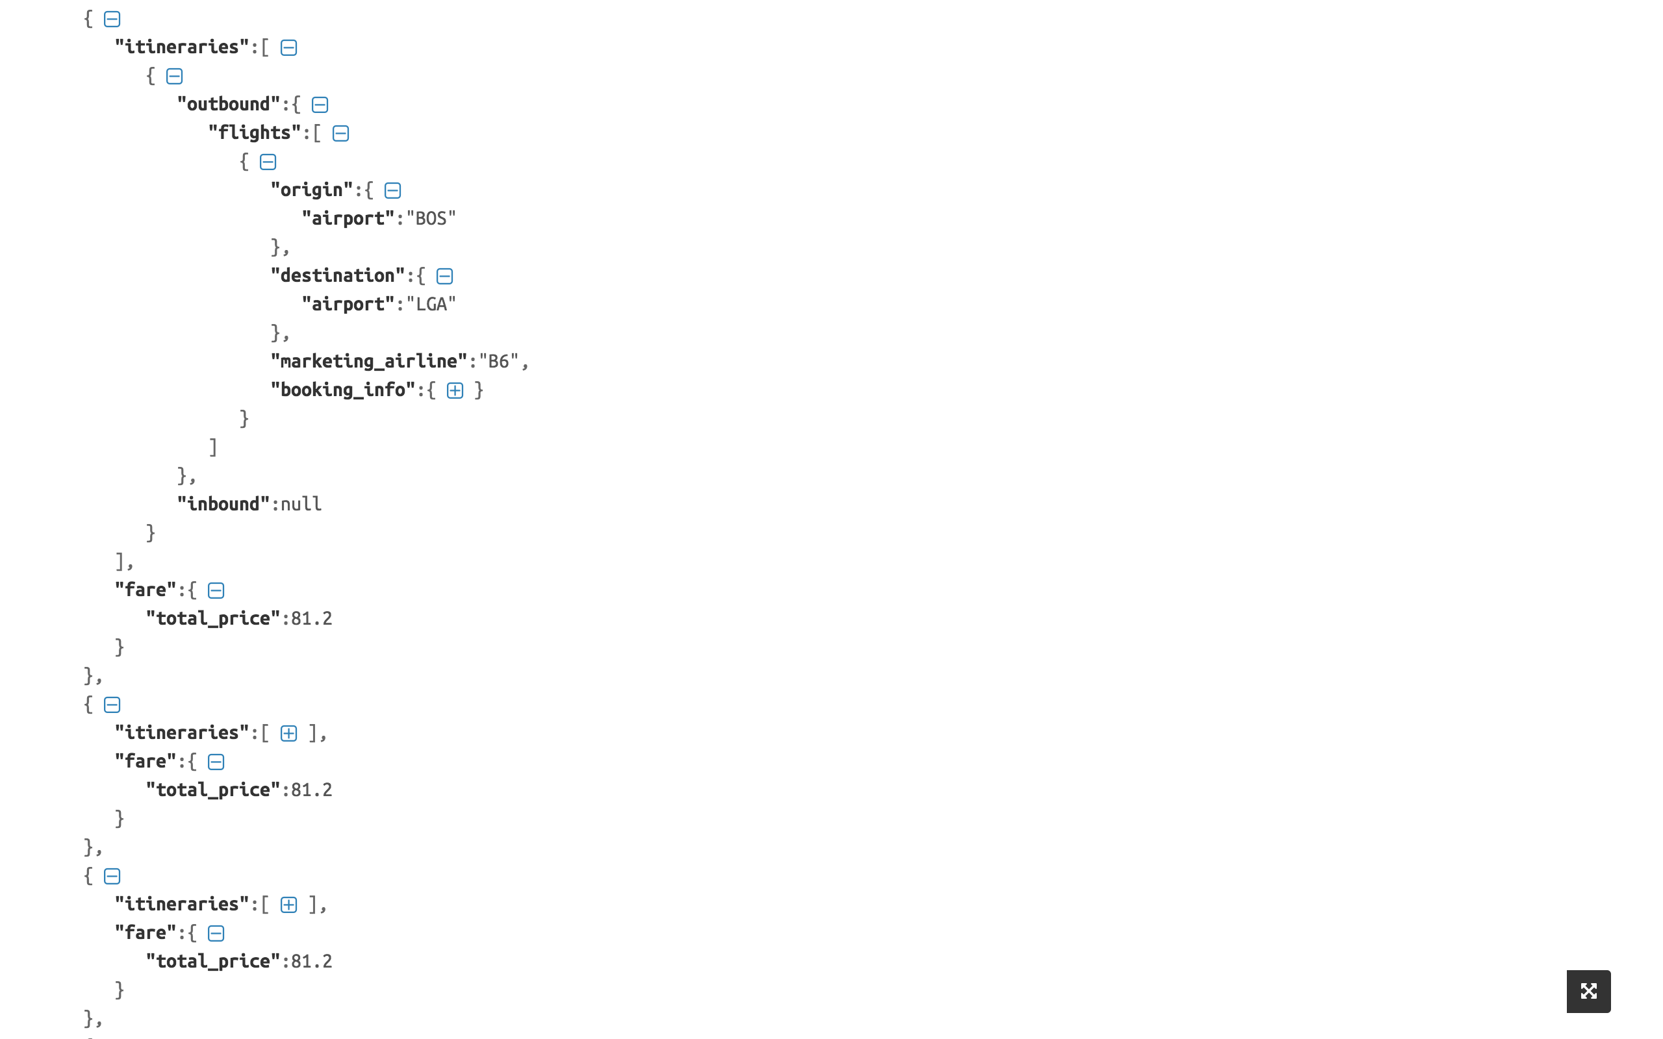
Screenshot (pretty printed data)

Slide 24
Thank You

